Slide 1
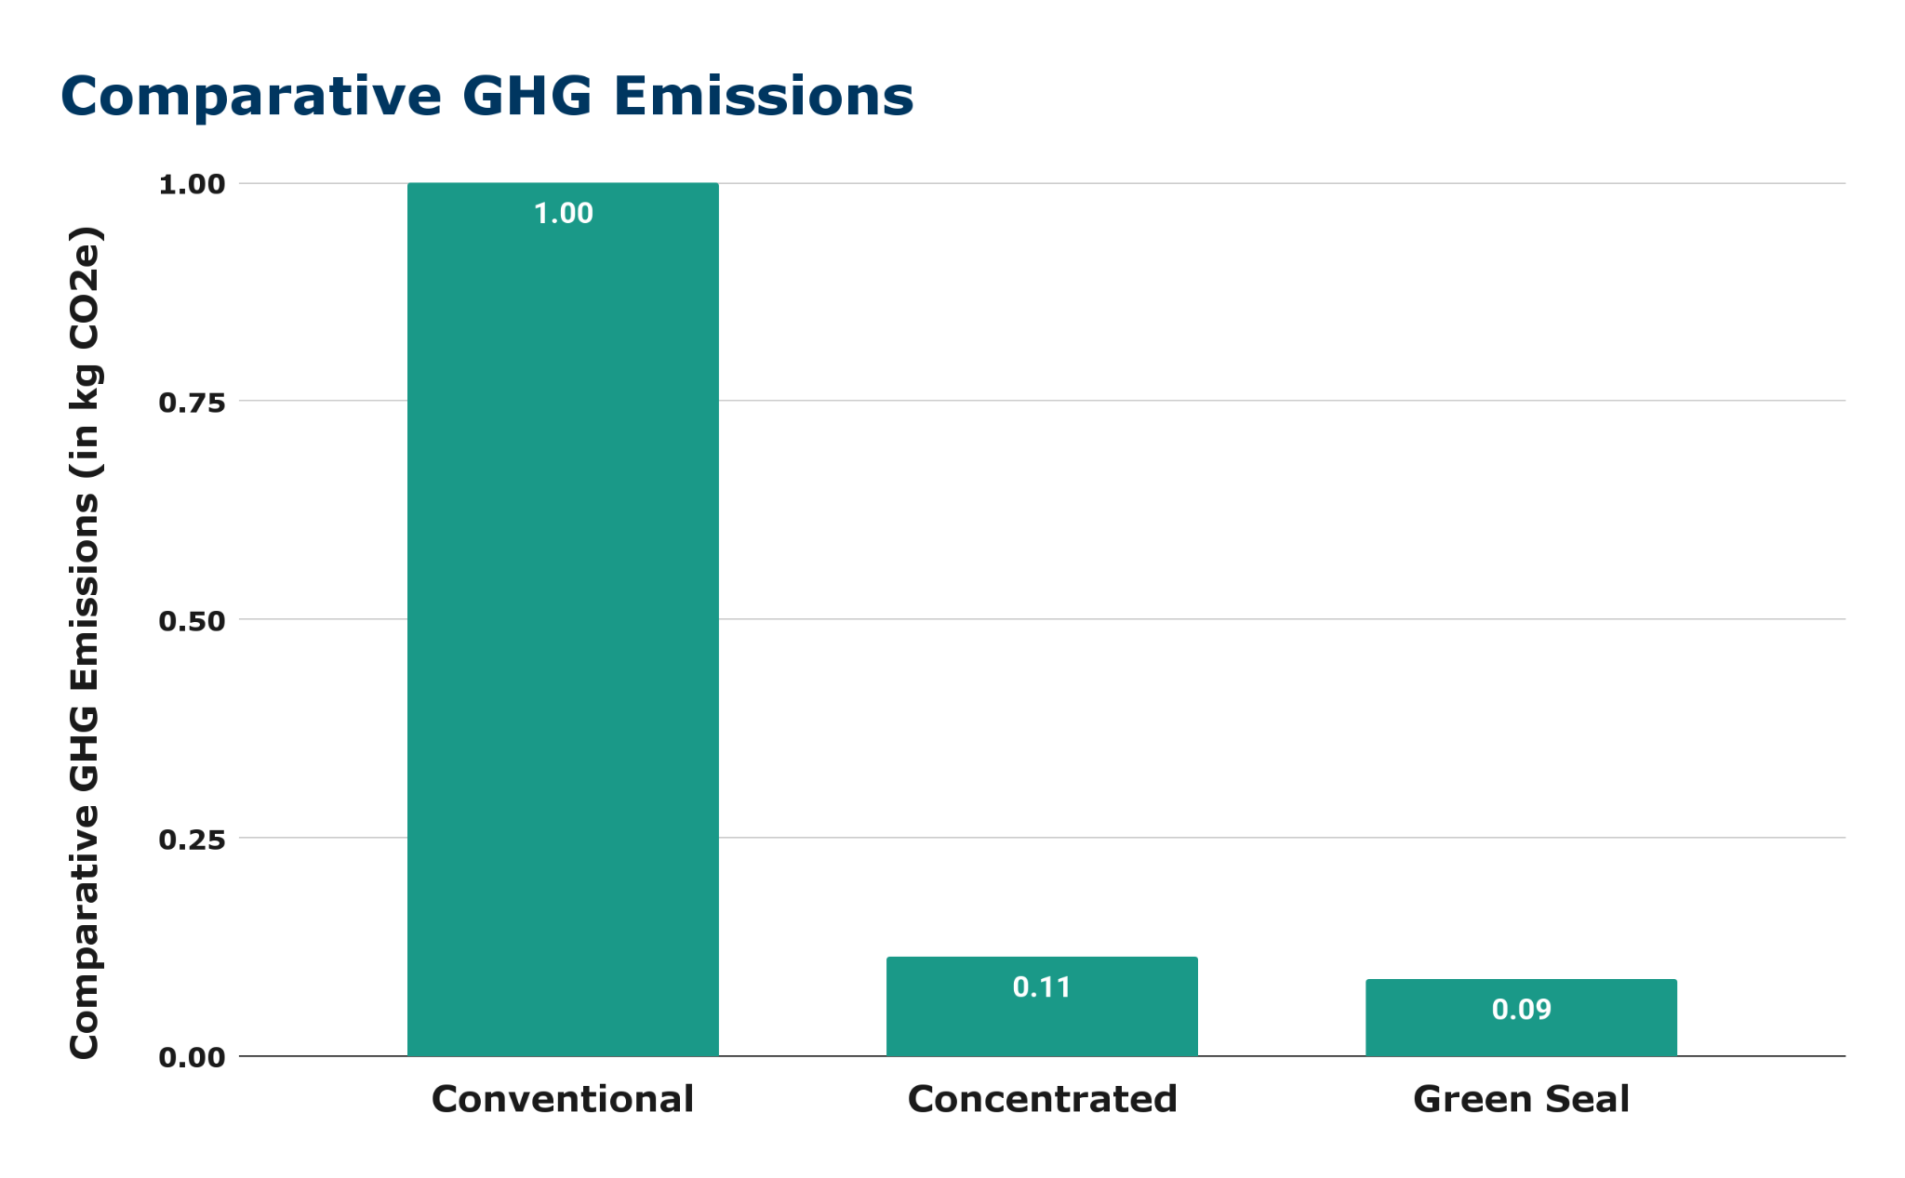
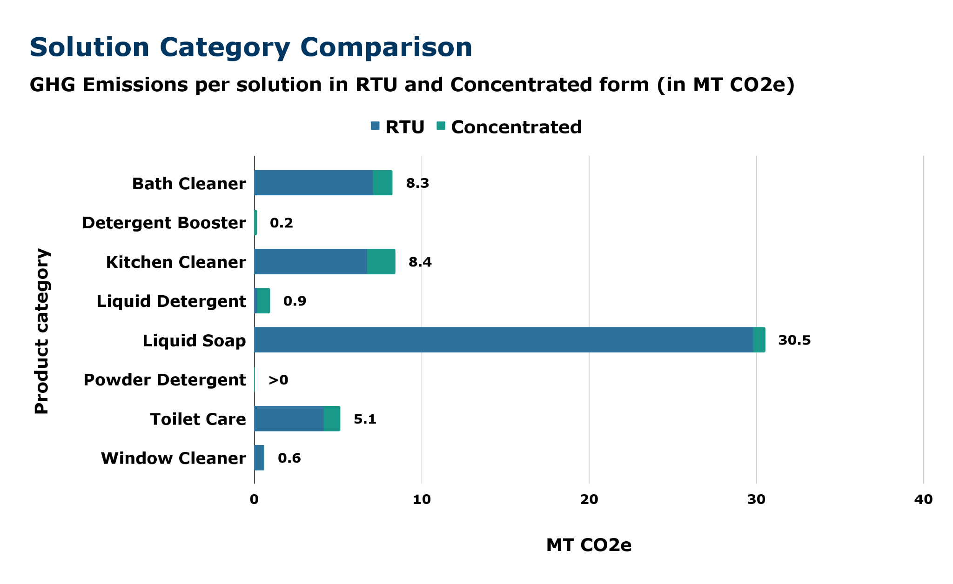
Estimating GHG Emissions from Procurement of Campus Cleaning Solutions
Jaret Valera
University of California, Santa Barbara Scope 3 Greenhouse Gas Emissions Research Intern
Abstract
Methodology
Emissions by Solution Specifications
Results
Green Seal & Deliverables
Cleaning solutions used in buildings can significantly impact the health of custodians and building occupants. Cleaning solutions which are not third party certified as more environmentally preferred are often formulated with harmful solutions, which could irritate the skin, eyes, nose, and throat. The UC System took on the responsibility to mitigate these issues by addressing them in the published UC Policy on Sustainable Practices. This policy commits the UC system to purchasing cleaning solutions that are third-party certified for their reduced environmental and health impacts.
Building on the initial commitment, this project aims to assess the greenhouse gas (GHG) emissions of cleaning solutions purchased by UC Santa Barbara (UCSB). Relevant peer reviewed articles and material safety data sheets were utilized to identify emissions factors and specifications of the solutions. This assessment solely focused on cleaning solutions; supplies such as paper towels, toilet paper, urinal maintenance products, and wet wipes were excluded.
Kapur, A., et al. (2012) compared the GHG emissions of cleaning solutions for industrial and institutional use that are either certified or not certified with the Green Seal certification standard, GS-37. Green Seal, a global nonprofit organization, is one of the certifications recognized by the UC Policy on Sustainable Practices.
Kapur, A et al. (2012) also compared emissions of ready-to-use (RTU) and concentrated solutions. RTU solutions and formulations are pre-prepared and do not require additional mixing, dilution, or preparation before use. They are designed for convenience and immediate application. Concentrated solutions have a lower volume & weight during shipping and need water to be added before use. The authors found emissions from concentrated solutions result in 89% less emissions than those of RTU conventional solutions . Solutions that are Green Seal certified and concentrated result in 91% less emissions than conventional solution.
Roughly $13,431 was spent towards Green Seal certified solutions. UCSB purchases a number of cleaning solutions that meet comparable certifications, which are also accepted by the UC Policy on Sustainable Practices. After analysis, we found that an additional $31,953 in spend met an approved certification other than Green Seal. $207,057 in spend was identified as a conventional solution. Overall only 30% of spend on cleaning solutions met an approved third party certification.
The resulting GHG emissions of conventional solution spend was 53.8 MT CO₂e compared to only 0.2 MT CO₂e for Green Seal certified solutions.
Besides Green Seal, an emissions factor was not identified for solutions certified with a third party environmental certification. Those solutions were assessed using the emissions factor for conventional solutions. This is likely an overestimate of emissions.
Throughout the course of this project, an emission calculation spreadsheet was developed which can be used as a template for future assessments and by other campuses. A methodology was also developed detailing the process used with references for assumptions made.
Limitations
Our analysis was based on GHG emissions factors available in the current peer reviewed literature on emissions of cleaning solutions. We were able to identify a GHG factor for Green Seal certified solutions, however we do not have a GHG metric for the rest of the third party certifications the UC system accepts. Given this, we used the emissions factors of conventional solutions (solutions without a third party environmental certification) for solutions certified with an environmental certification other than Green Seal. It is likely this lead to an overestimate of emissions.
Emissions factors by solution category were based on Koehler, A., et al. (2009) research. There were no clear definitions for these categories. Additionally, the authors were not available to answer questions about their paper. As a result, we had to infer the definitions of the categories from their names.
Future Goals
UCSB can reduce its carbon footprint from cleaning solutions by shifting to concentrated and Green Seal certified solutions where available and feasible.
Switching to concentrated solutions could drop emissions to 11 MT CO₂e, a 43 MT CO₂e reduction. If we were to switch to purchasing all Green Seal certified solutions and concentrated solutions, the emissions would be reduced to only 8.6 MT CO₂e, a 45.5 MT CO₂e reduction.
Results
Overall & Concentrated Solutions
Through this study, it was estimated that UCSB’s purchases of cleaning solutions in fiscal year (FY) 2022-2023 resulted in 54 MT CO₂e. This is equivalent to the annual operations of about 12 typical gasoline-powered cars.
Total spend for FY 22-23 was $220,488 in cleaning solutions. $69,883 was spent on RTU cleaning solutions, and $150,606 was spent on concentrated cleaning solutions. The total emissions from RTU solutions was greater than that of concentrated solutions, at 48.5 MT CO₂e compared to 5.6 MT CO₂e.
The solution category with the largest GHG impact was liquid soap, emitting 30.5 MT CO₂e. This was also the category that had the greatest percentage of RTU spend. Concentrated forms of this solution are available.
Methodology
Emissions by Category
Bibliography
Data on the total spend of cleaning solutions from Ecolab, Grainger, ODP, Waxie, and Amazon, our five largest cleaning solution suppliers, were obtained from Procurement Services (UCSB and UC Office of the President (UCOP)).
A literature review was completed to identify the emissions factors. Koehler, A., et al. (2009) outlined the environmental impacts of production and consumer use of several cleaning solutions. They grouped solutions into categories of chemicals and determined a cumulative energy demand (CED) for each solution. In this assessment, CED energy data was converted into GHG emissions using the 2024 EPA GHG Emissions Factors Hub.
Assessments were based on nine solution categories identified by Koehler, A., et al. (2009): kitchen, window, bathroom cleaners, liquid detergents, powder detergents, detergent booster, liquid soaps, bar soaps, and toilet-care solutions. Assumptions are based on average shipping conditions nationally, and do not account for where solutions originate.
EPA GHG Emissions Factors Hub (2024), https://www.epa.gov/climateleadership/ghg-emission-factors-hub
Kapur, A., Baldwin, C., Swanson, M. et al. (2012). Comparative life cycle assessment of conventional and Green Seal-compliant industrial and institutional cleaning products. Int J Life Cycle Assess 17, 377–387.
Koehler, A., Wildboz, C., (2009). Comparing the environmental footprints of home-care and personal-hygiene products: the relevance of different life-cycle phases. Environ Sci Tech 43:8643–8651
Acknowledgement
I would like to acknowledge and thank Katie Maynard, Jewel Persad, and Jen Bowser for their support and assistance in making this project successful.

